Slide 1
Budget Buddy
Dynamic computational analysis of transactions in a retail environment

Slide 2
Team Members and Roles
Harrison Black - Mobile App Functionality
Jacob Chaulk - Data Visualization and DB
Jesus Duran - Web App API
Tuan Pham - React Native & Web App UI
Terrell Richardson - Android App UI
Tom Serrano - React Native App
Sixiong Yang - Android App UI

Slide 3
Functional Requirements
Price input using camera or manual input
Mobile interface with running total
Database for transaction storage
Web application for transaction history
Android and iOS compatibility

Slide 4
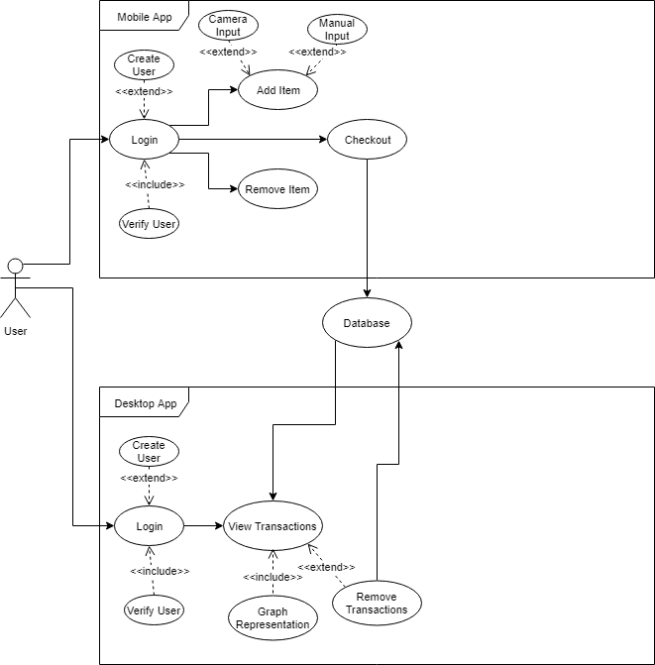
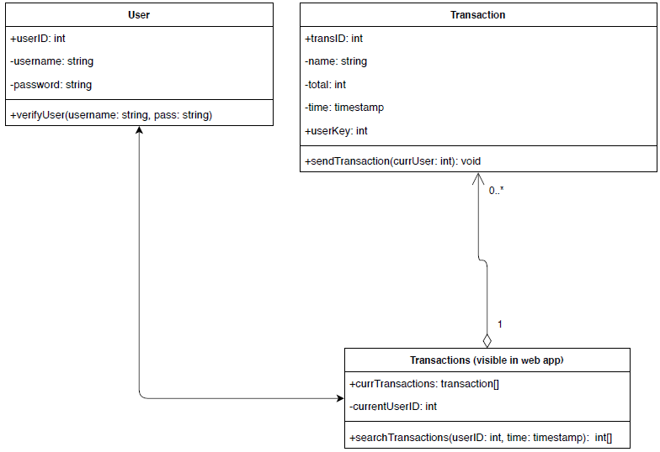
UML Diagrams

Slide 5
Mobile Application Price Input
Ability to scan prices with the device’s camera using OpenCV and Tesseract libraries
Ability to manually input prices

Slide 6
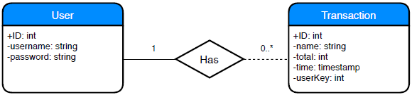
Database Services
Deploy both web and mobile applications via Amazon Web Services
Link both applications to the same relational DB

